Slide 1

SOAR
We are Central Eagles!
Watch us SOAR!

Slide 2
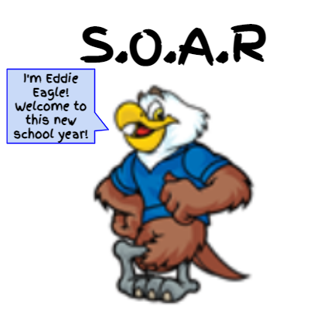
Welcome
Back!

Slide 3

S
O
A
R

Slide 4
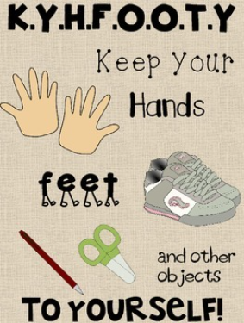

Slide 5
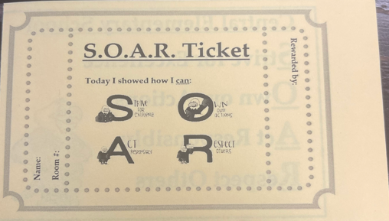
SOAR Tickets

Slide 6
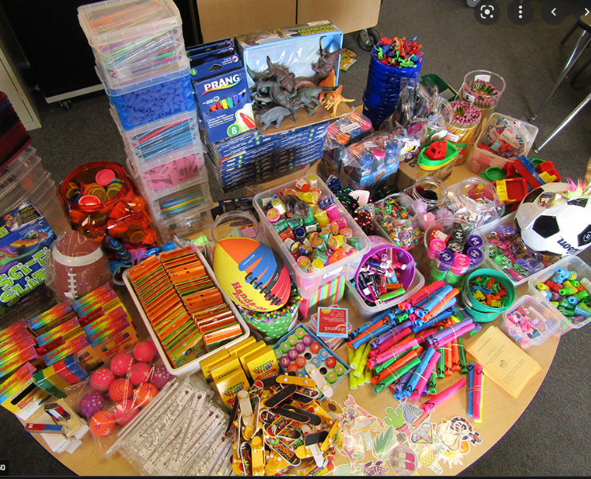
SOAR
Store

Slide 7

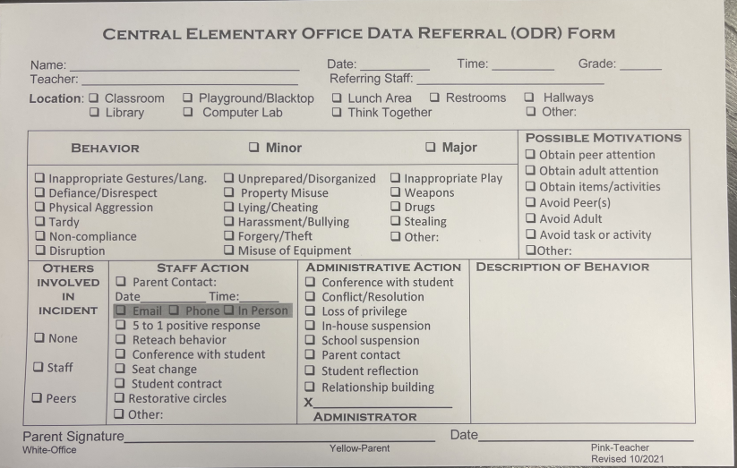
ODM

Slide 8
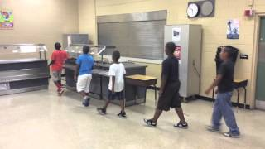
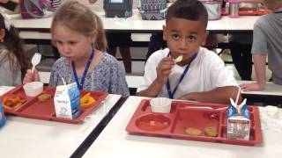
How to SOAR in the Cafeteria

Slide 9
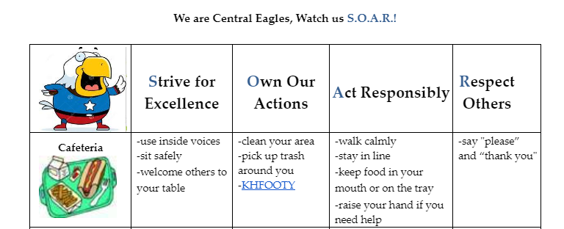


Slide 10
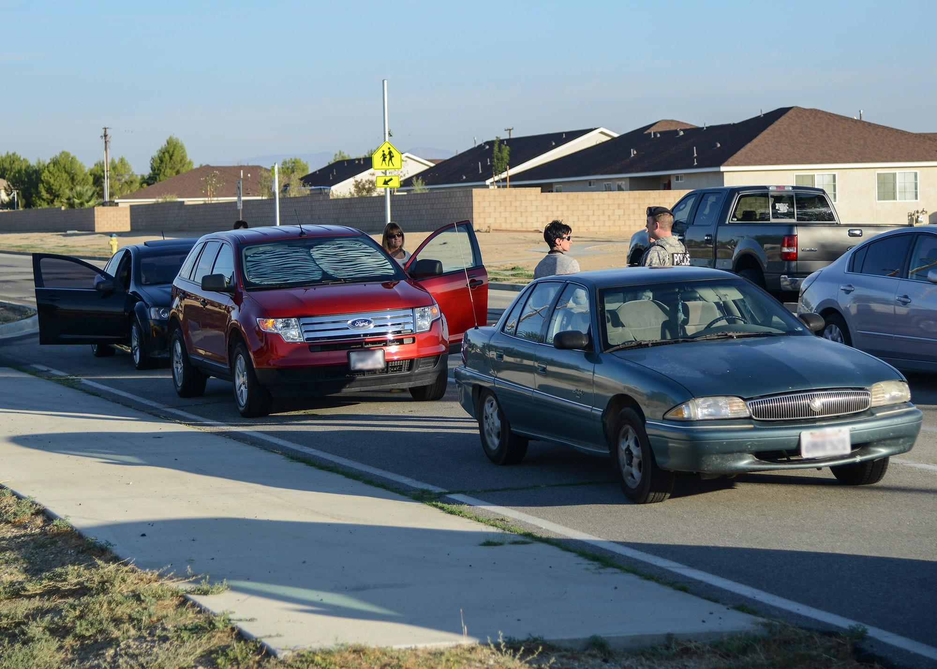
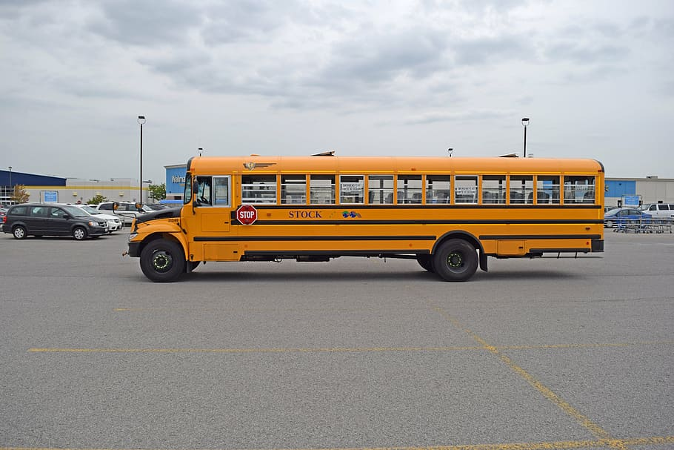
Parking
Lot

Slide 11

Drop Off & Pick Up Area

Slide 12
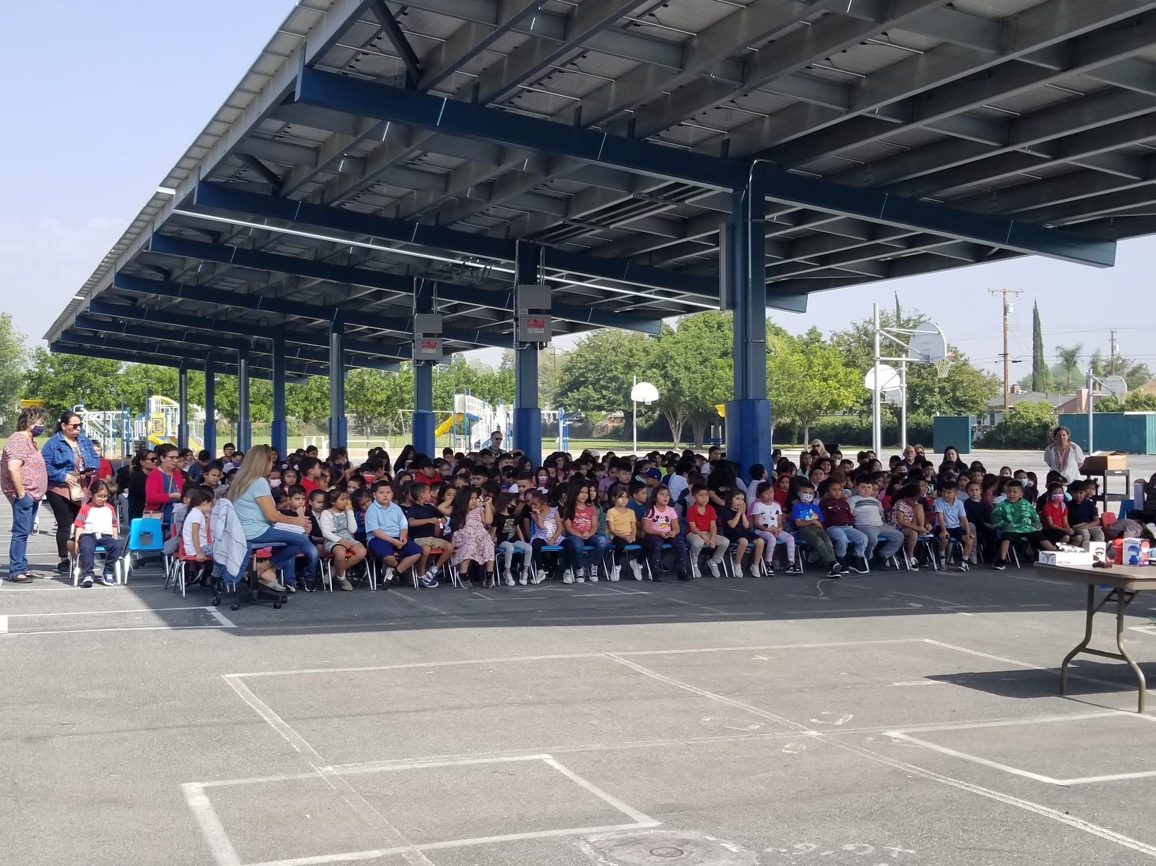
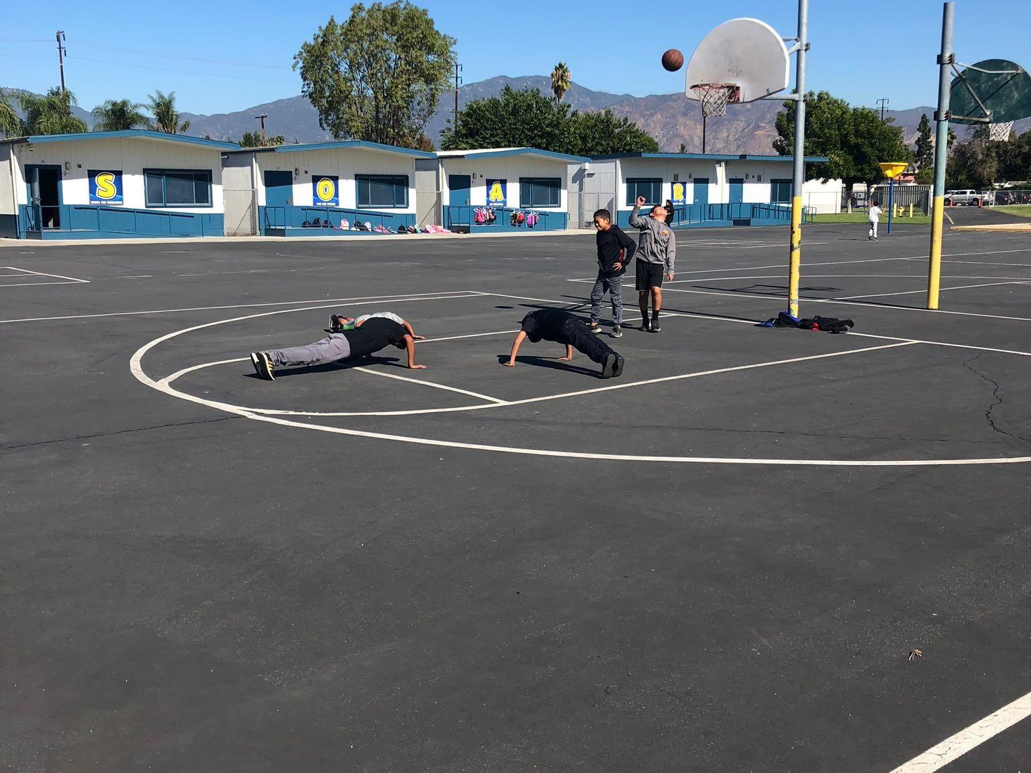
Playground

Slide 13

Playground

Slide 14
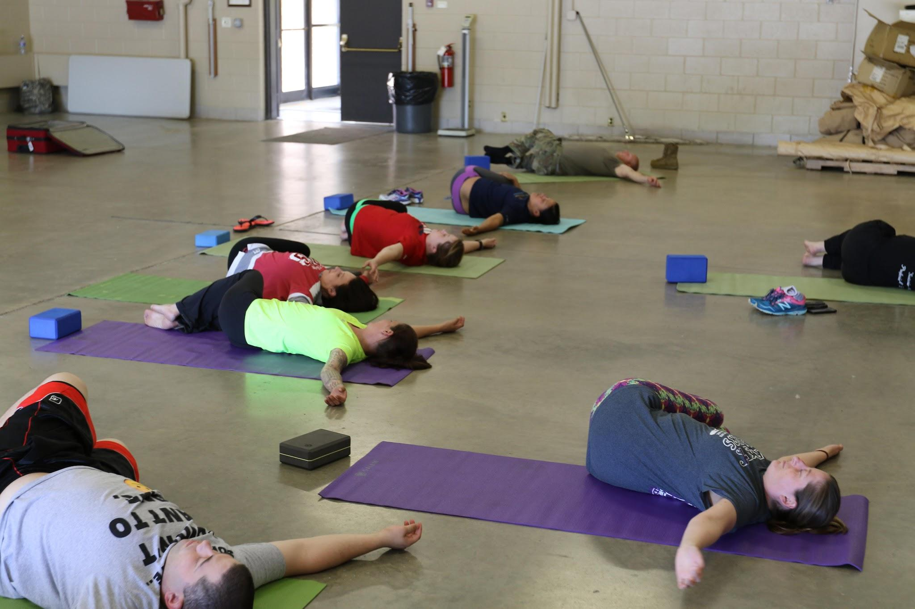
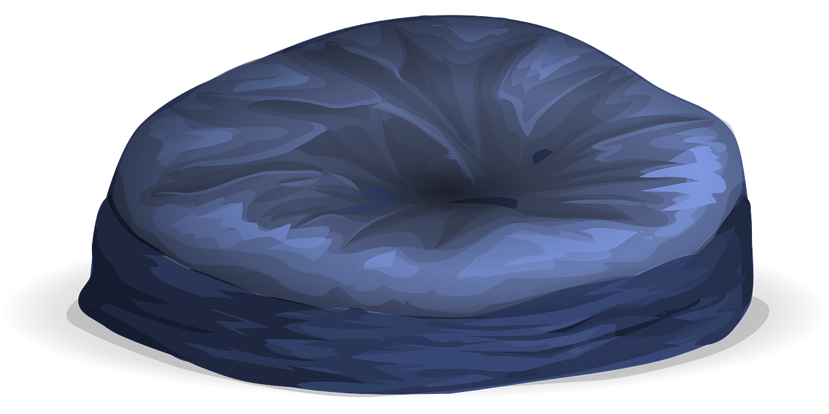
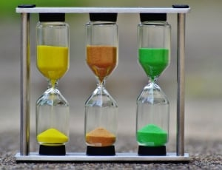
Calming Room

Slide 15

Calming Room

Slide 16
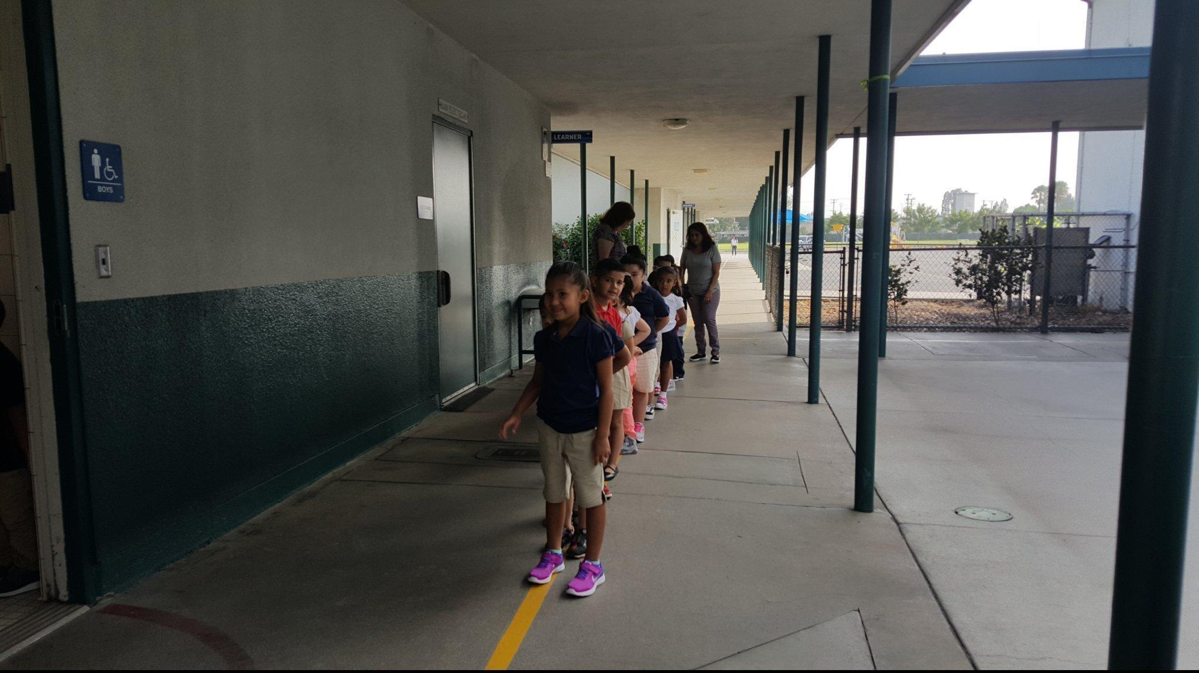
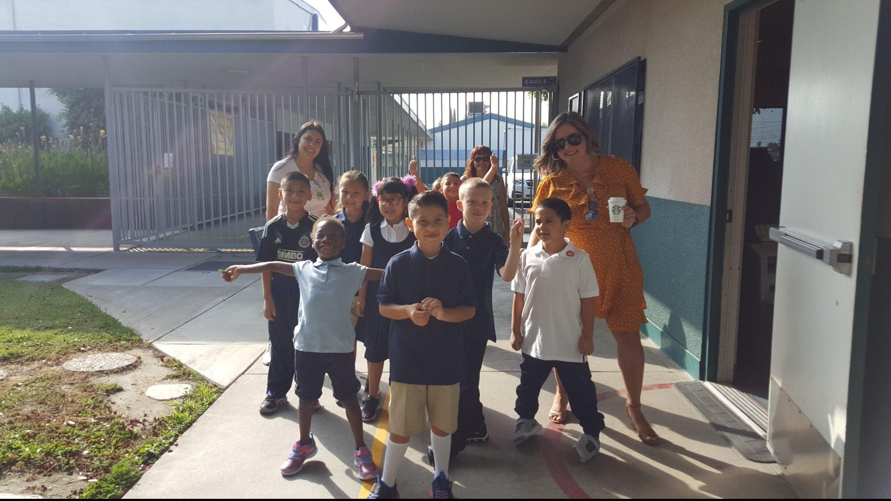
Restrooms and Hallways

Slide 17

Hallways and the Restroom

Slide 18
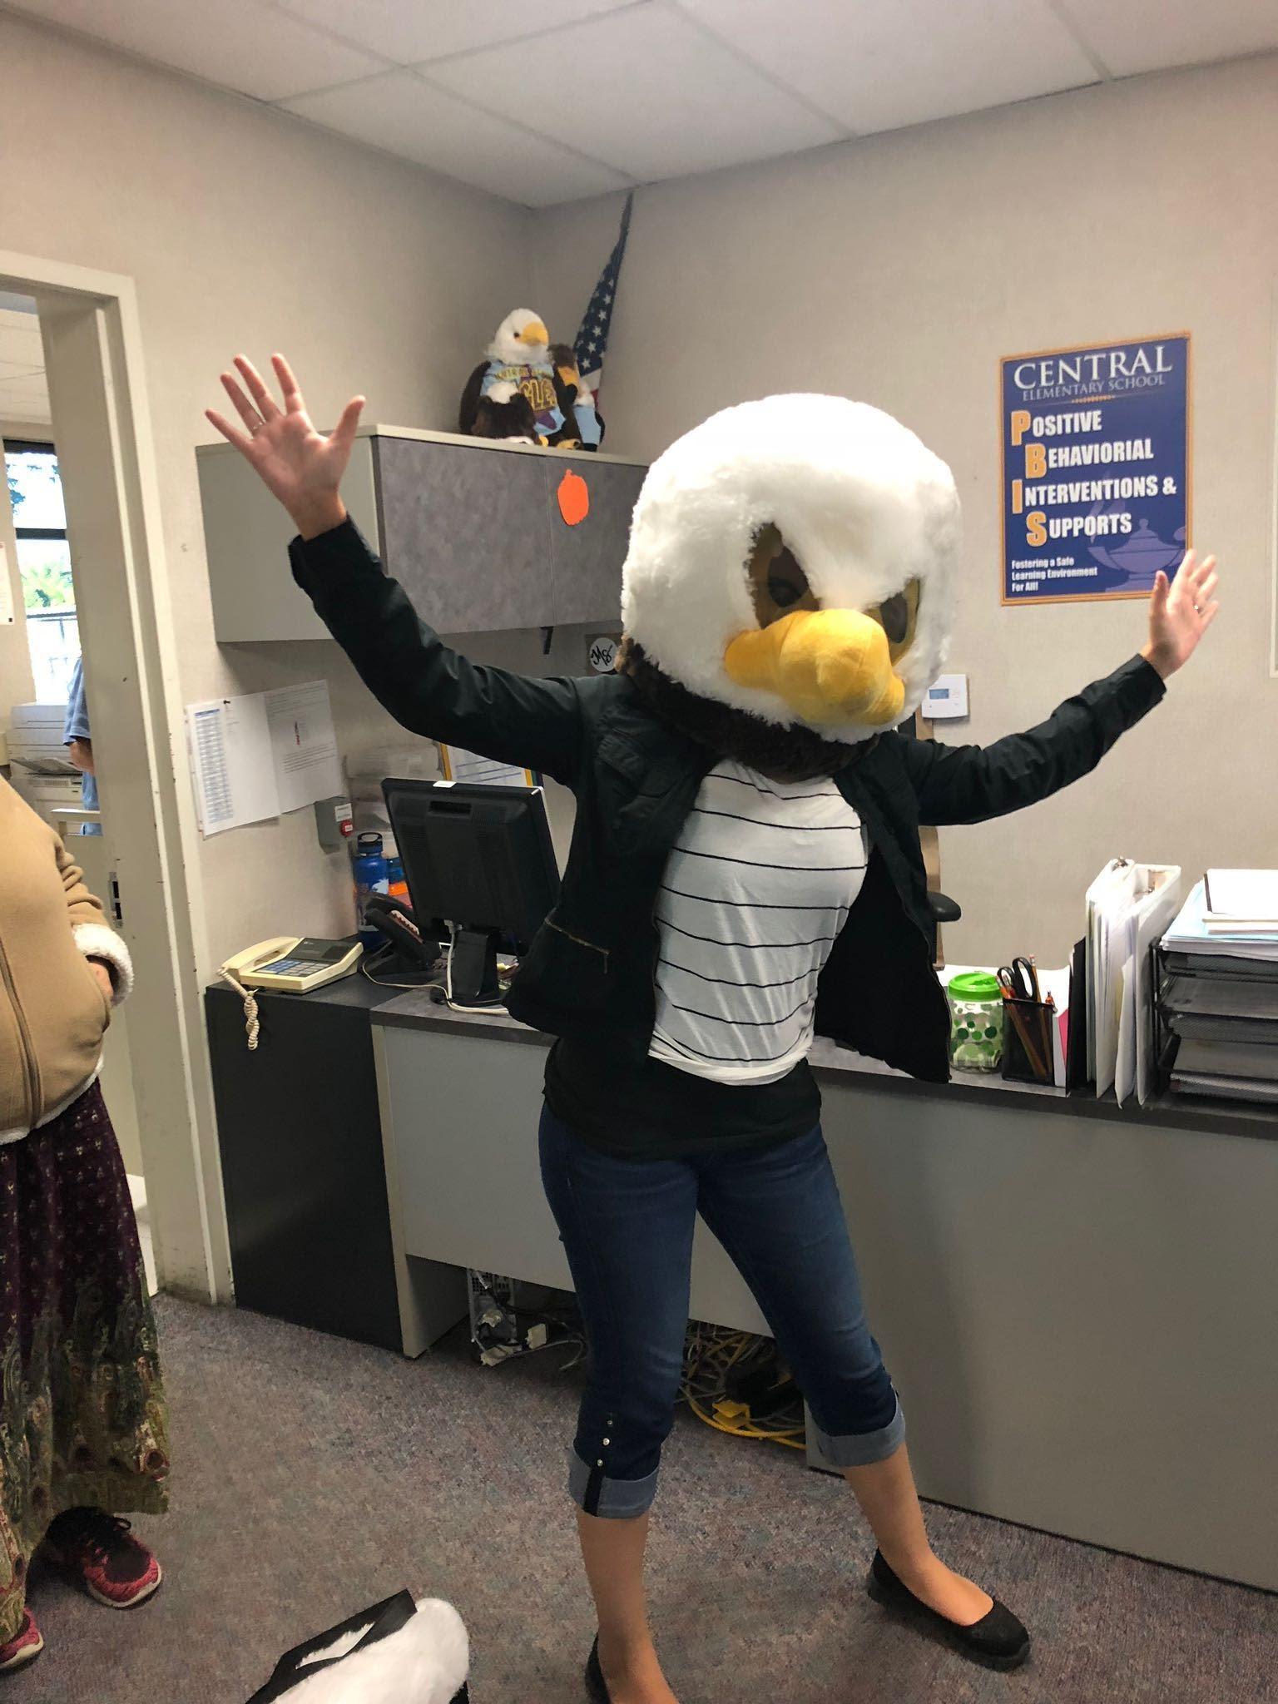
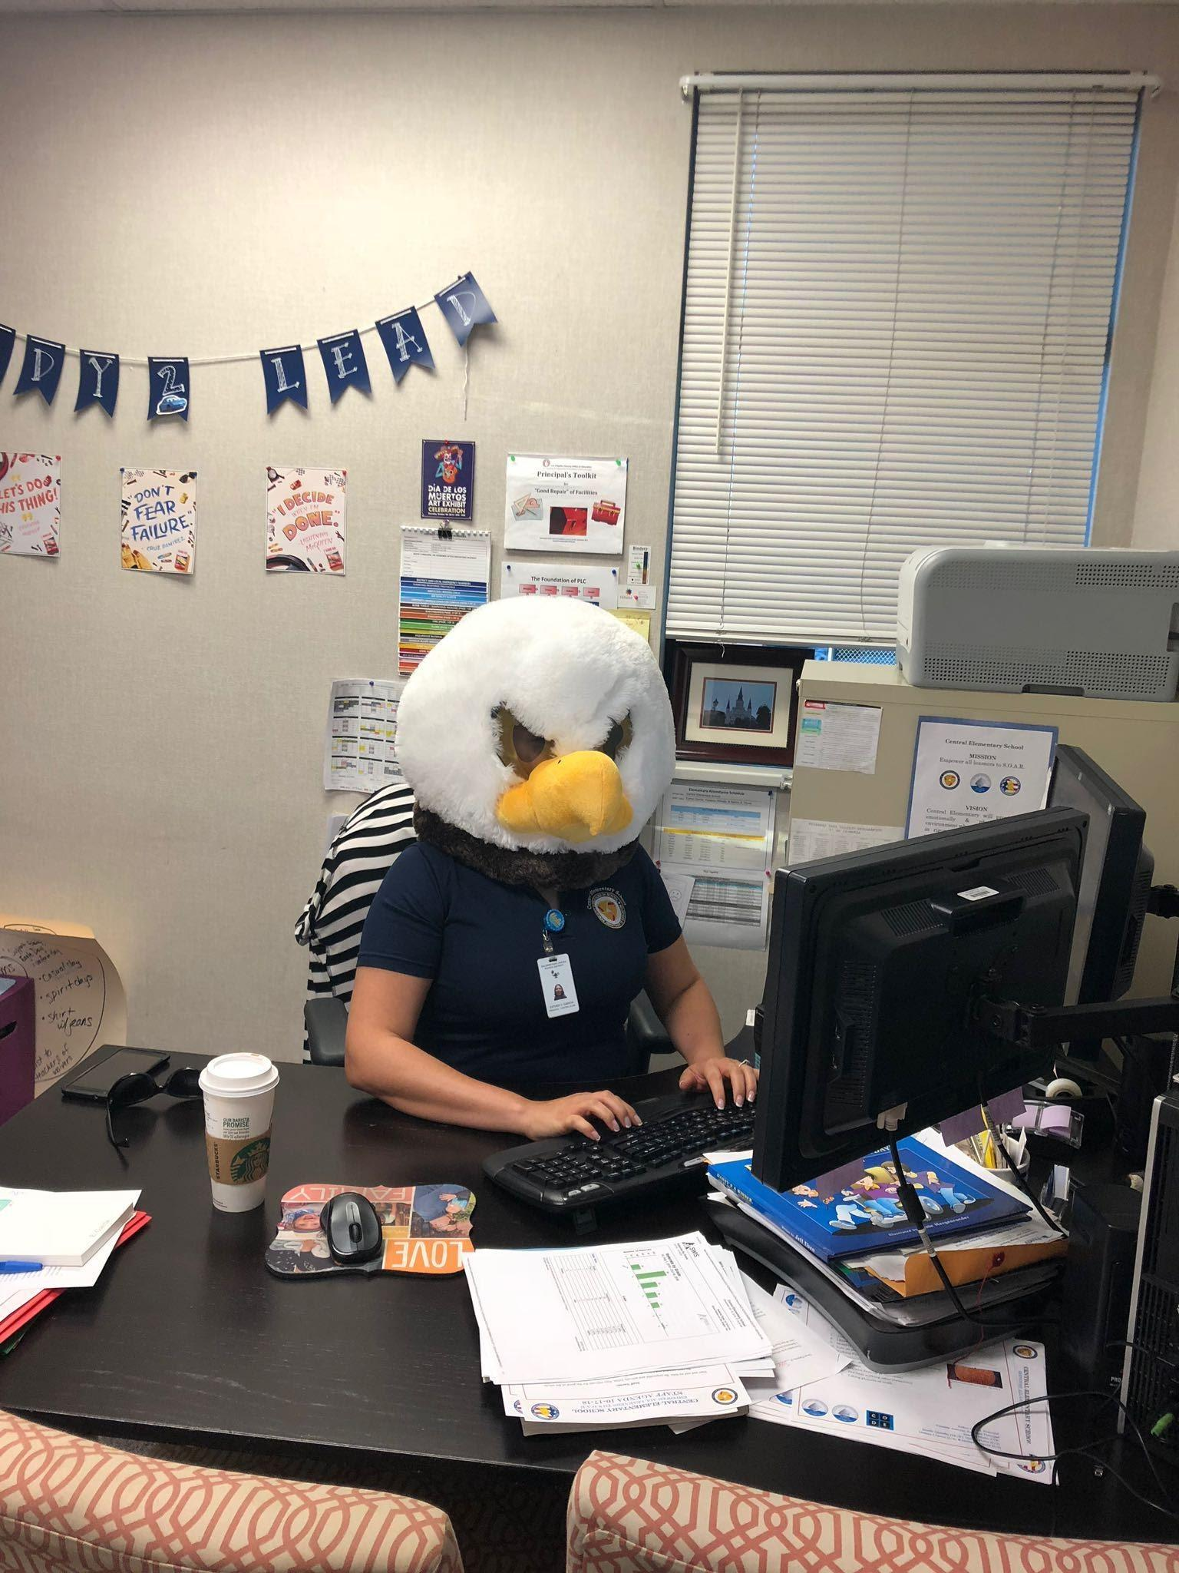
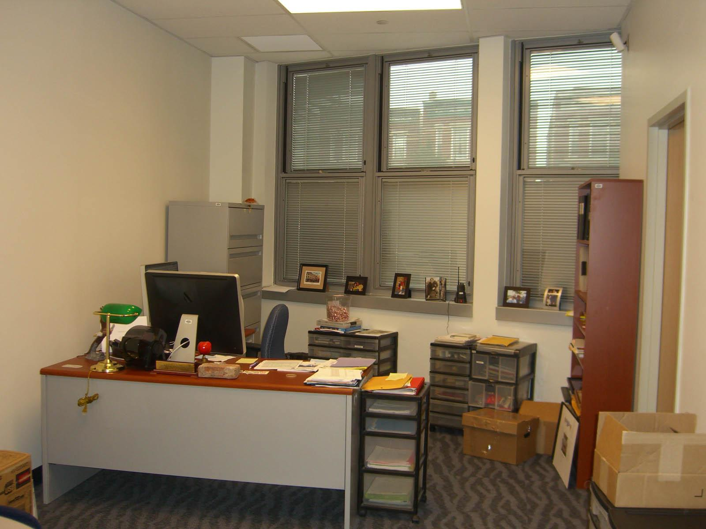
Office

Slide 19

Office

Slide 20
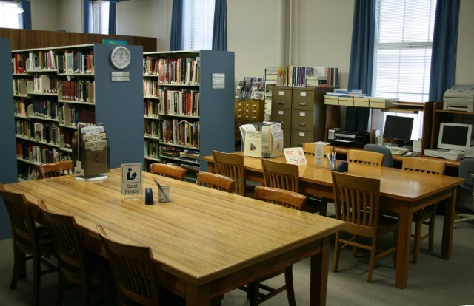
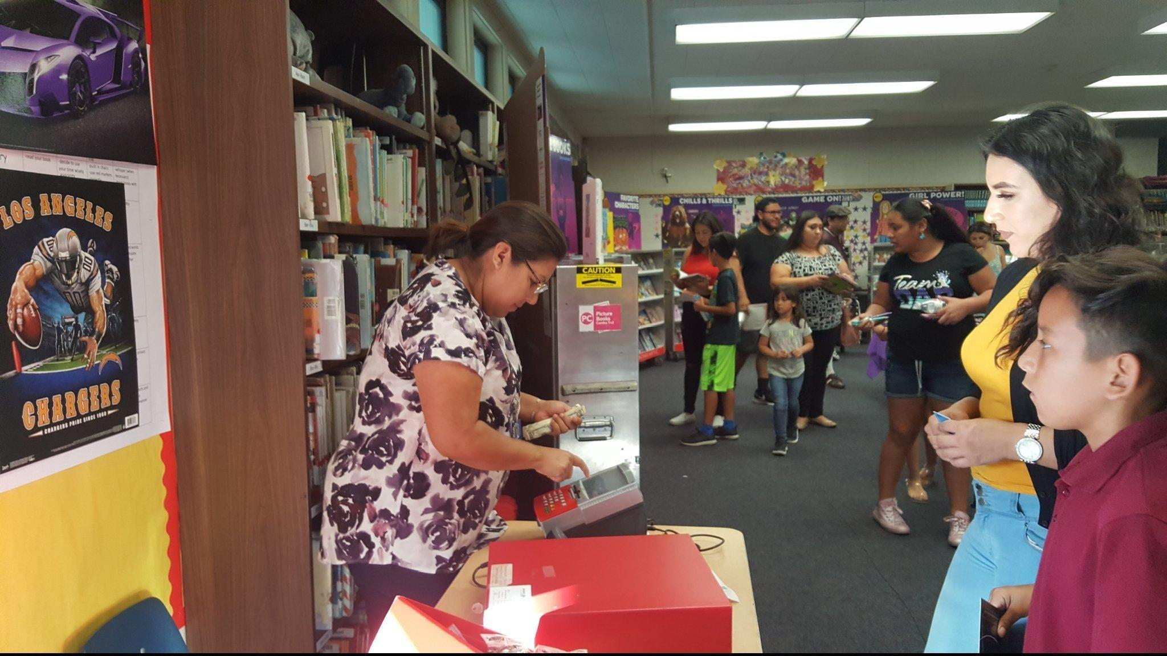
Library

Slide 21

Library

Slide 22

SOAR in your Classroom

Slide 23
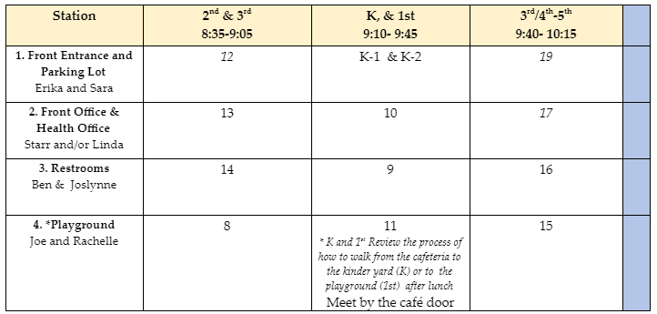
Today's Rotation Schedule

Slide 24
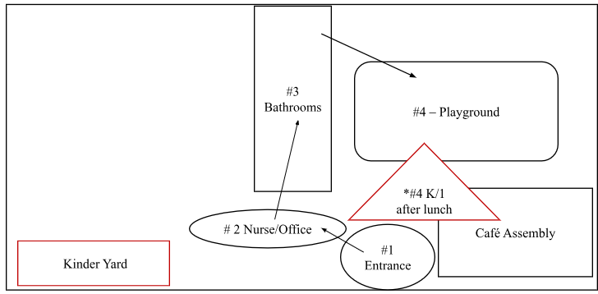
Rotation Map

Slide 25
S.O.A.R.
Strive For Excellence
Own Our Actions
Act Responsibly
Respect Others

Slide 26
Central Eagle SOAR all day, every day, in every way possible
Why?
Because we are Central Eagles!
Watch us SOAR!

